Slide 1
Name | ID
Md.Mehedi Hasan | 163432581
Md.Mosiur Rahman | 163432547
Rahul Basak Santo | 163432532
Aminul Islam | 163432556
 | M1516039
Md . Nazrul Islam | M1516077

Slide 2

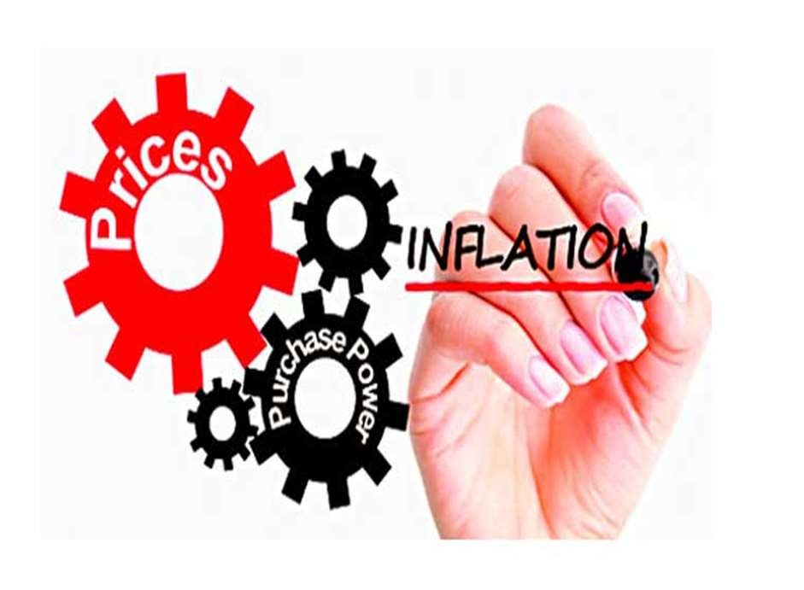
Topic: Inflation in Bangladesh

Slide 3

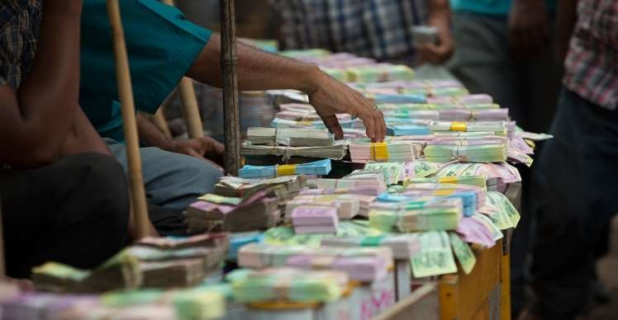
Objectives
The objective of the term paper is to analyze the condition of inflation in Bangladesh

Slide 4

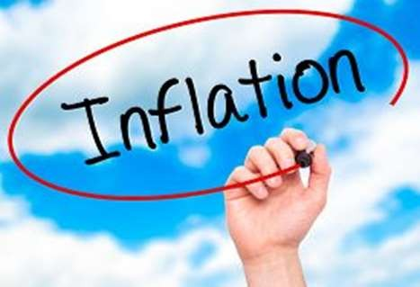
What is inflation?
Inflation is defined as a sustained increase in the general level of prices for goods and services.
For example, if the inflation rate is 2% annually, then theoretically a $1 pack of gum will cost $1.02 in a year. After inflation, our dollar can't buy the same goods it could beforehand.

Slide 5
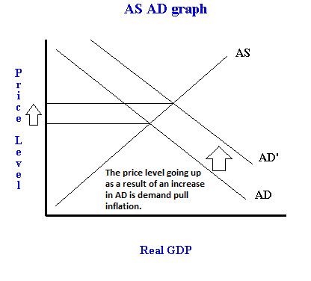
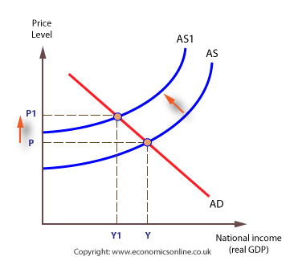
Types of inflation
Demand – Pull Inflation
Cost – Push Inflation

Slide 6

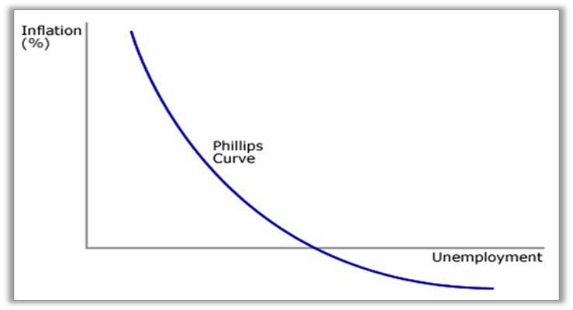
Causes of inflation
Excess money supply
Inflation is always and everywhere a monetary phenomenon Low interest rates correspond with a high level of money supply MV = PQ
Unemployment
There is an inverse relation between rate of inflation and the rate of unemployment in an economy

Slide 7

Costs of Inflation
Creditors lose and debtors gain if the lender does not anticipate inflation correctly.
Uncertainty about what will happen next makes corporations and consumers less likely to spend.
People living off a fixed-income, such as retirees, see a decline in their
purchasing power and, consequently, their standard of living.
The entire economy must absorb repricing costs as menu costs.
If the inflation rate is greater than that of other countries, domestic products become less competitive.

Slide 8
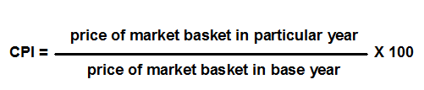
How Inflation Measure?
g
 Consumer Price Index (CPI)
 Producer Price Indexes (PPI)
The PPI indicates changes in producer prices of locally produced commodities including exports.

Slide 9

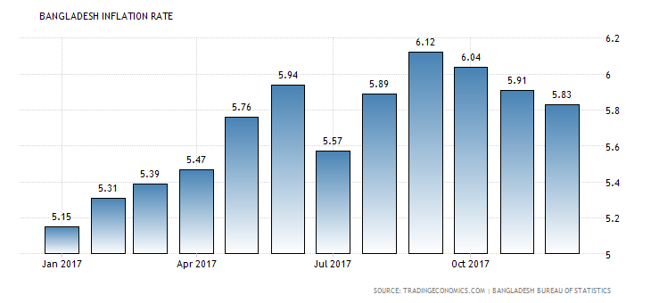
The recent inflation situation in Bangladesh
Actual | Previous | Highest | Lowest | Dates | Unit | Frequency
6.04% | 6.12 | 16.00 | -0.03 | 1994-2017 | Percent | Monthly

Slide 10

Inflation of Food & Non-Food
9
8.46
8.36
8
7
6
5
3.77
3.89
4
3
2
1
0
Food
Non Food
February,2016
March,2016

Slide 11

The Inflation in Urban & Rural Area
February, 2016
March, 2016
7.22
7.27
4.76
4.79
URBAN
RURAL

Slide 12


Food inflation in urban and rural area
5.48
5.61
3.04
3.15
URBAN
RURAL
February, 2016 March, 2016

Slide 13







Non-Food inflation in urban and rural area
9.5
9.14
9.12
9
8.5
7.97
8
7.82
7.5
7
Urban
Rural
February, 2016
March, 2016

Slide 14











Inflation rate in SAARC Countries
11
9.6
9.5
7.6
7.7
6.8
4.7
5.1
Bangladesh
India
Pakistan
Srilanka
Nepal
Bhutan
Maldives
Afganistan

Slide 15

Effects of inflation in the economy of
Bangladesh
An increase in the general level of prices implies a decrease in the purchasing power of the currency. That is, when the general level of prices rises, each monetary unit buys fewer goods and services.

Slide 16

General effects of inflation
Purchasing power.
Uneven effect distribution of inflation in economy.
Effect on real value.

Slide 17

Positive effects of inflation
Labor-market adjustments.
Room to maneuver.
Mundell-Tobin effect.

Slide 18
Negetive effects of inflation
Cost-push inflation.
Hoarding.
Hyperinflation.
Allocate efficiency.
Shoe leather cost.
Menu costs.

Slide 19

CONTROL MECHANISMS FOR INFLATION IN
BANGLADESH:
Short term mechanisms
Monetary policy
Fiscal policy
Direct tax increase
Decrease in PSNCR
a) Direct wage controls
Long term mechanisms
a) Supply

Slide 20

Measures Taken by Bangladesh Government to
Reduce Inflation
Fixation of prices
Interest on securities
Credit flow
Wicked syndicate and market monitory

Slide 21

CONCLUSION
Inflation ….it should be kept in a limit. The government of Bangladesh should take necessary steps to keep it undercontrol. Between the two mitigation techniques Bangladesh government should keep its eye on the underlying reasons behind inflation. Bangladesh can mitigate the rising food price if government can take necessary steps in increasing the production of food grains in Bangladesh. Bangladesh govt also has to increase employment facility by increasing the number of investment in production sector. If more industrialization can be occurred then the GDP will increase and the inflation will be mitigated. Bangladesh bank and also use the monetary weapons that they have over inflation. So, controlling of inflation for short term is not what our country needs to emphasize rather the long term solution is needed.

Slide 22

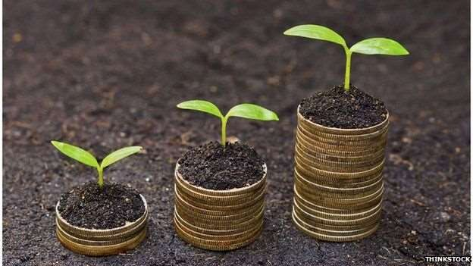
Is inflation good?

Slide 23



Slide 24



